Slide 1



High Emissivity Coatings for Ethylene Furnaces
DOW Open Day, Terneuzen, 29/01/2020
Stijn Vangaever¹, Joost Van Thielen², Marko Djokic¹, John Olver³, Kevin Van Geem¹
¹Laboratory for Chemical Technology, Ghent, Belgium
²CRESS, Breskens, The Netherlands
³Emisshield, Virginia, USA

Slide 2
Introduction:
High Emissivity Coatings

Slide 3

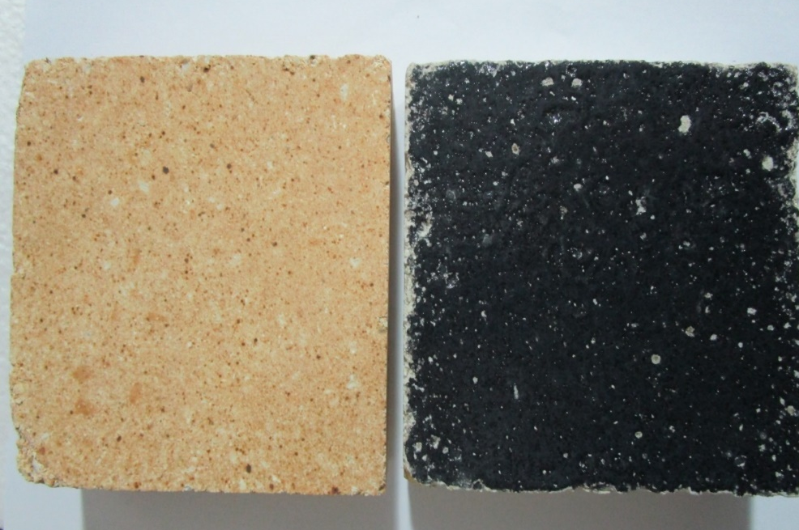
Energy emitted from ethylene radiant wall by increasing wall emissivity
“ …the measure of the ability of a body to absorb or emit energy when compared to a black body at the same temperature.”
Black body 1200ºC
Grey Body ԑ = 0.9
Non-grey brick ԑ = 0.4
Emissivity
0.4 0.9
3/24
©Copyright 2020 Emisshield® ALL RIGHTS RESERVED | 2000 Kraft Drive, Ste. 2600 | Blacksburg, VA 24060 | (540)-961-0999
Joost Van Thielen, Stijn Vangaever

Slide 4

Emissivity Coatings - Background
Emisshield and CRESS have been developing and applying HE materials for 10+ years in Europe.
IMPROOF selected the CRESS/Emisshield Team to evaluate HE materials for this project to improve furnace efficiency, reduce fuel, increase production and reduce CO₂ emissions.
The Emisshield Products come from the NASA Space Program’s R&D and have been utilized on space vehicle applications.
Ongoing R&D at Emisshield ensures continued development and improvements
in Emisshield Products coming to the ethylene producers marketplace.
4/24
©Copyright 2020 Emisshield® ALL RIGHTS RESERVED | 2000 Kraft Drive, Ste. 2600 | Blacksburg, VA 24060 | (540)-961-0999
Joost Van Thielen, Stijn Vangaever

Slide 5
Emisshield Coating Systems
-Performance Requirements-
Developed by NASA - provides thermal performance improvement to any material by composite use - heating or cooling
Thermal Stability - to 4700 °C for continuous duty
Thermal Shock - tested from -200 °C to 1500 °C in 3 seconds - no failure
Adhesion - withstands MACH 23 and Thermal Shock Bonding Strength > 5000 psi
Hemispherical and Spectral Emissivity - > 0.9
Thin Filmed - Must be less than 75 µm (3 mil) in thickness for maximum Performance.
5/24
©Copyright 2020 Emisshield® ALL RIGHTS RESERVED | 2000 Kraft Drive, Ste. 2600 | Blacksburg, VA 24060 | (540)-961-0999
Joost Van Thielen, Stijn Vangaever

Slide 6
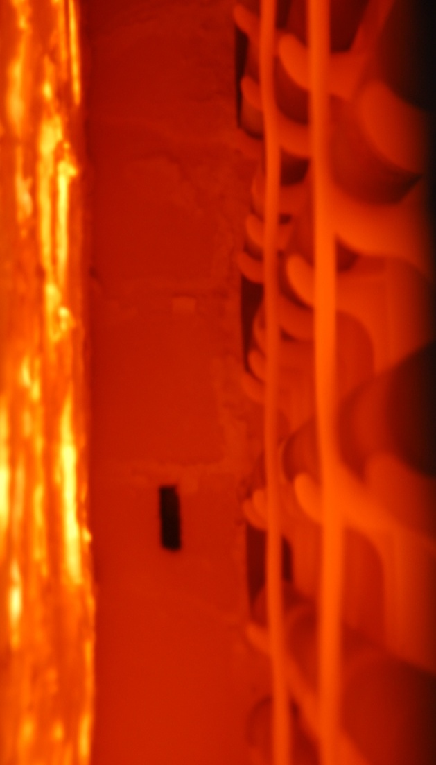
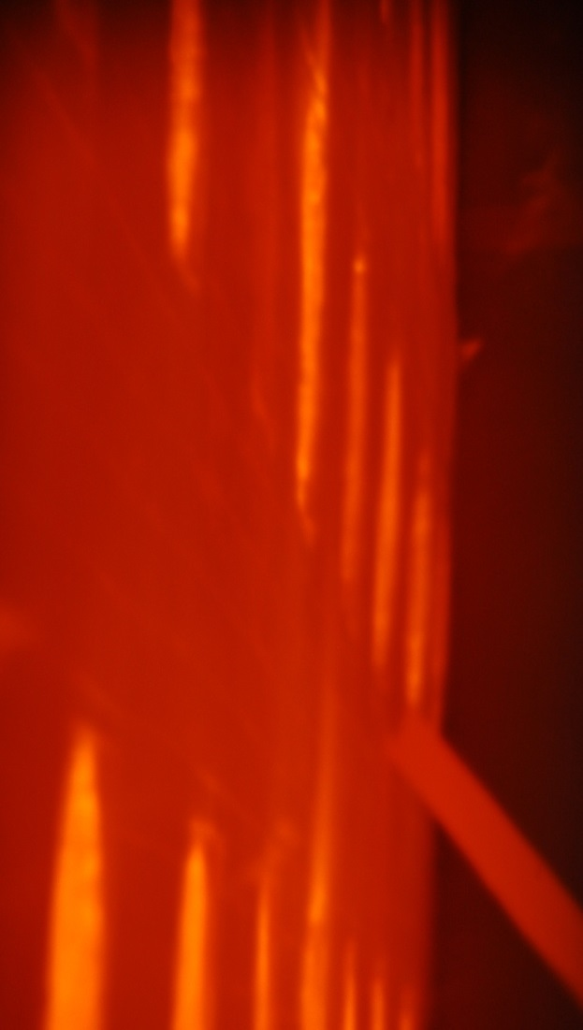
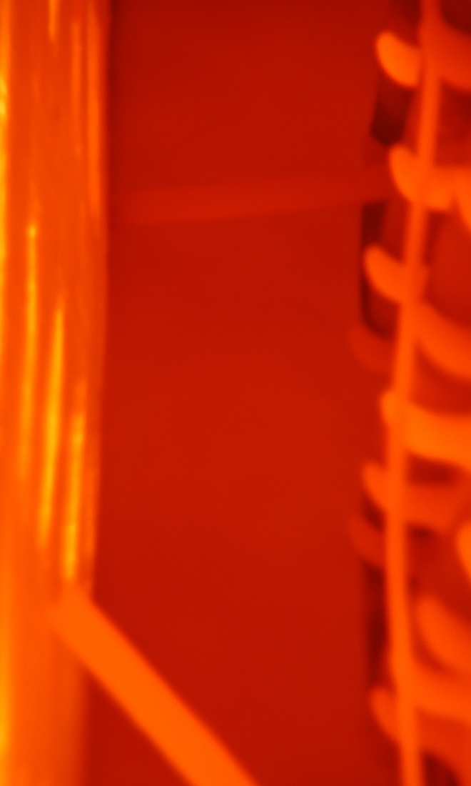
Emisshield Ethylene Furnace Project
Before
After
After
6/24
©Copyright 2020 Emisshield® ALL RIGHTS RESERVED | 2000 Kraft Drive, Ste. 2600 | Blacksburg, VA 24060 | (540)-961-0999
Joost Van Thielen, Stijn Vangaever

Slide 7
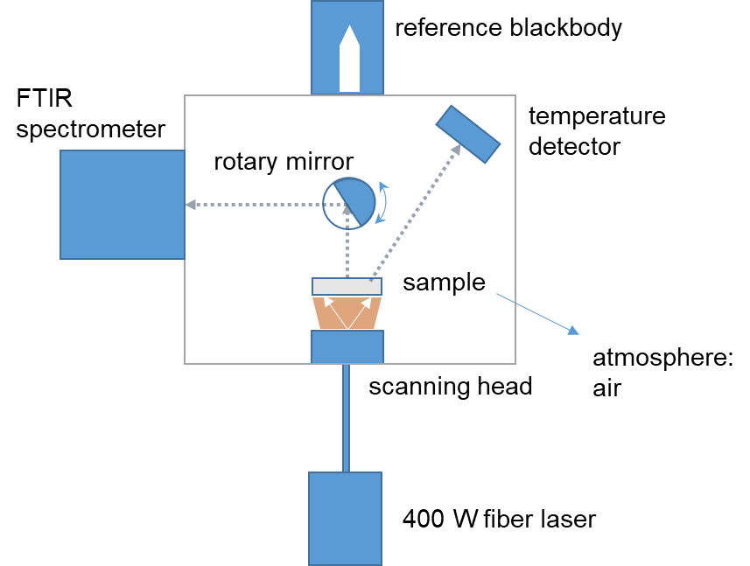
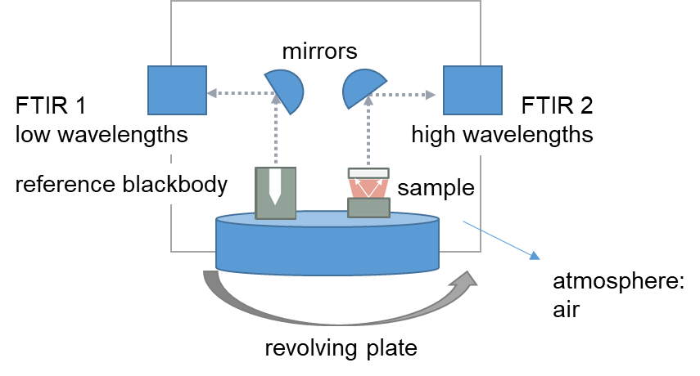
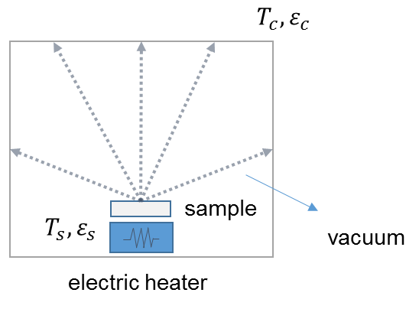
3rd Party Emissivity Testing for IMPROOF
3rd party tests of emissivity and HE coatings must be done at the operating temperature of the furnace and by independent 3rd party testing laboratories.
An HE Specification has been developed for HE coating use in ethylene worldwide.
For all IMPROOF work - all emissivity measurements were done at temperature and by these independent laboratories:
      Thermophysical Properties Research Lab - TPRL, USA
      University of West Bohemia, Pilsen, Czech Republic
      CNRS-CEMHTI, Orléans, France
Joost Van Thielen, Stijn Vangaever

Slide 8
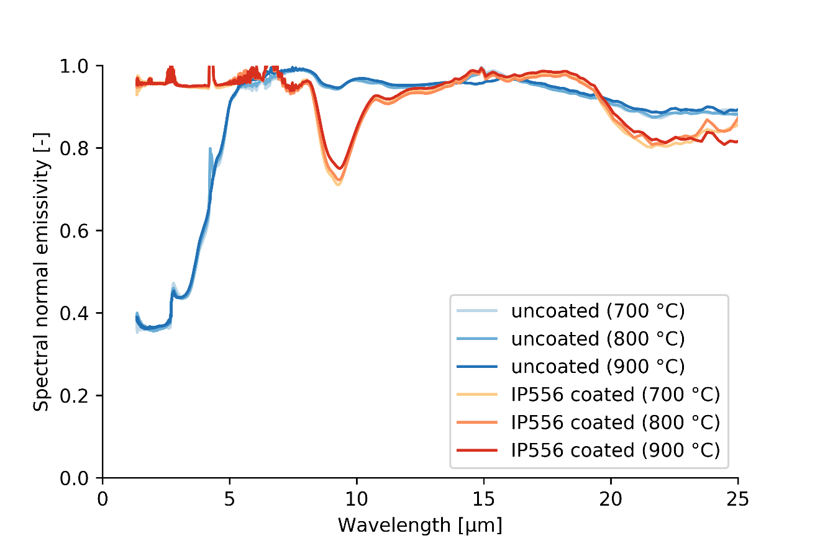
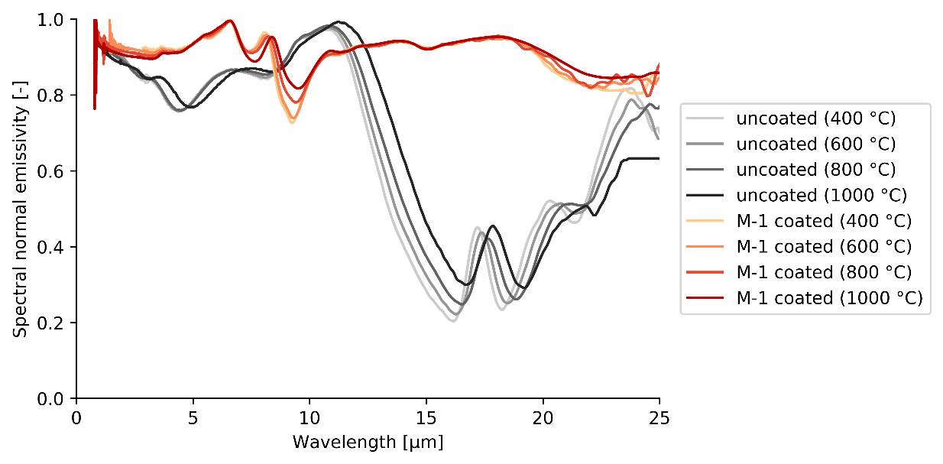
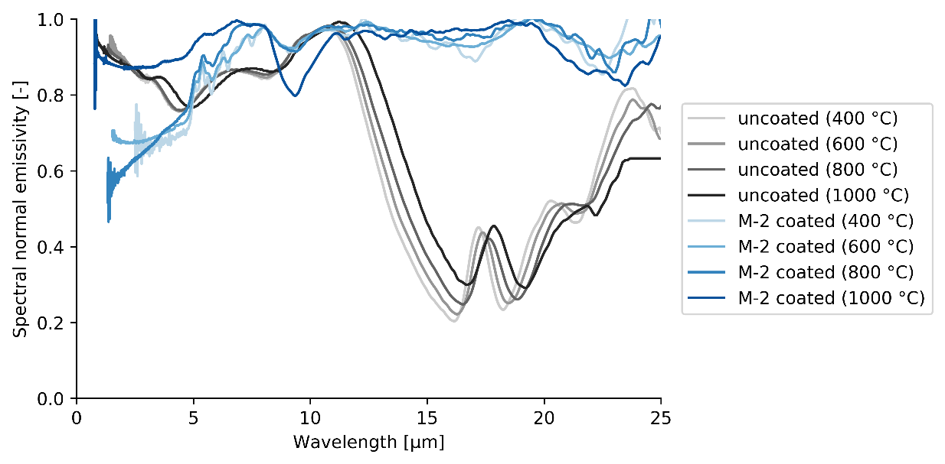
Spectral normal emissivity – Refractory & Process Tubes
Refractory – Radiant walls Metal – Process Tubes
Joost Van Thielen, Stijn Vangaever

Slide 9
Experimental validation:
UGent steam cracking pilot plant

Slide 10
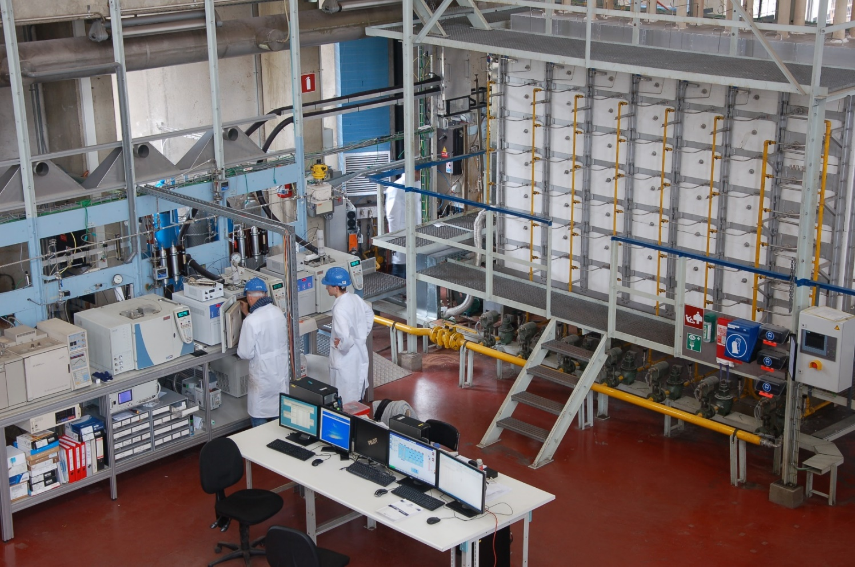
Steam cracking experiments
Experimental set-up: pilot plant @ LCT UGent
Operating conditions (6 h cracking cycle):
10 kg/h propane
4 kg/h water
644 °C coil inlet temperature
2 bar coil inlet pressure
0.9 s residence time
90 % conversion
Continuous measurement:
process gas temperature
tube metal temperature
refractory wall temperature (inside and outside)
flue gas temperature
burner pressure before every cell (1-4)
volumetric flow rate to cracking cells (3-4)
Vangaever, S., Reyniers, P. A., Symoens, S. H., Ristic, N. D., Djokic, M. R., Marin, G. B., & Van Geem, K. M. (2020). Pyrometer-based control of a steam cracking furnace. Chemical Engineering Research and Design.
Joost Van Thielen, Stijn Vangaever

Slide 11
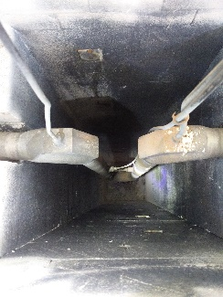
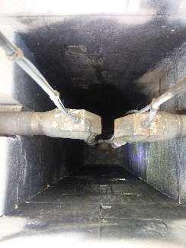
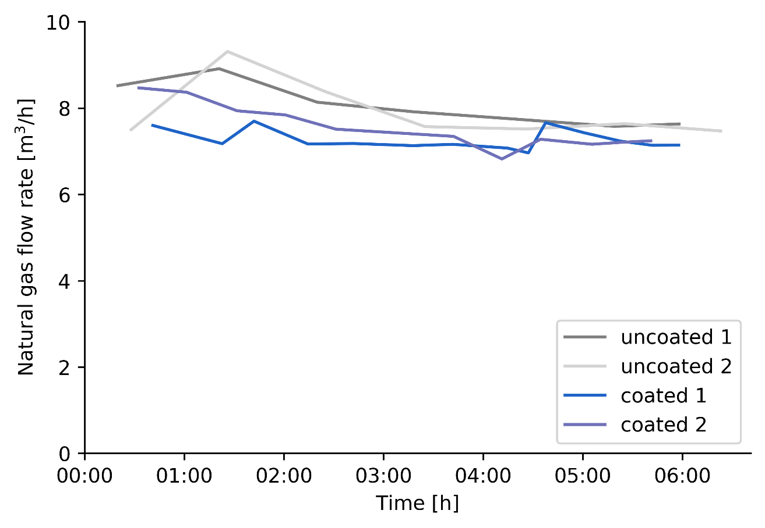
Steam cracking experiments
Experimental set-up: pilot plant @ LCT UGent
Operating conditions (6 h cracking cycle):
10 kg/h propane
4 kg/h water
644 °C coil inlet temperature
2 bar coil inlet pressure
0.9 s residence time
90 % conversion
Applied Emisshield coating did not pass QA/QC!
Periodic sampling:
Total natural gas flow rate to the furnace:
5 % energy savings
Joost Van Thielen, Stijn Vangaever

Slide 12
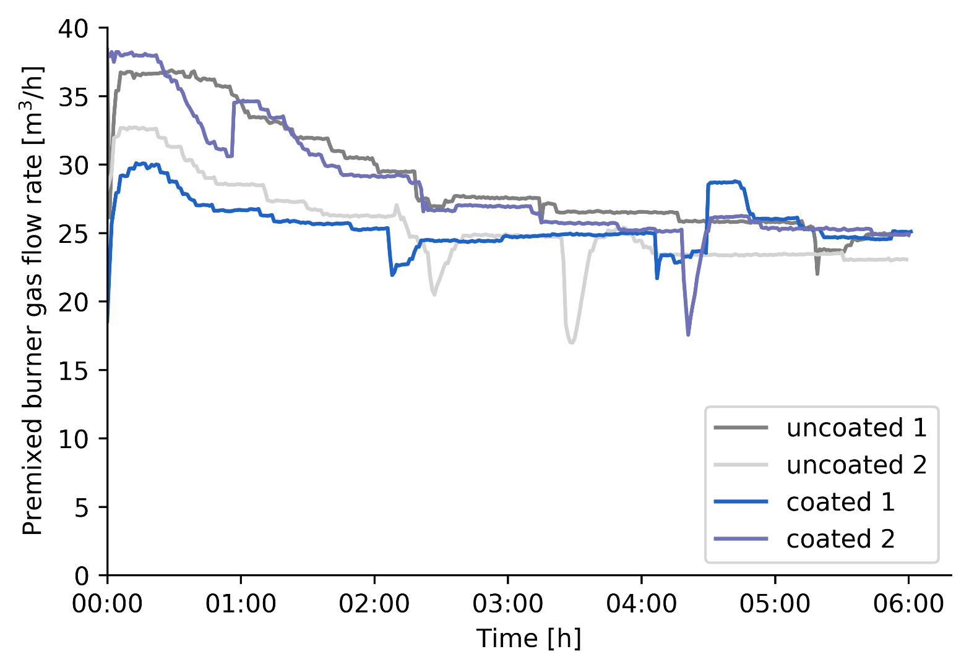
Steam cracking experiments
Total premixed burner gas flow rate to cells 3 & 4
Joost Van Thielen, Stijn Vangaever

Slide 13
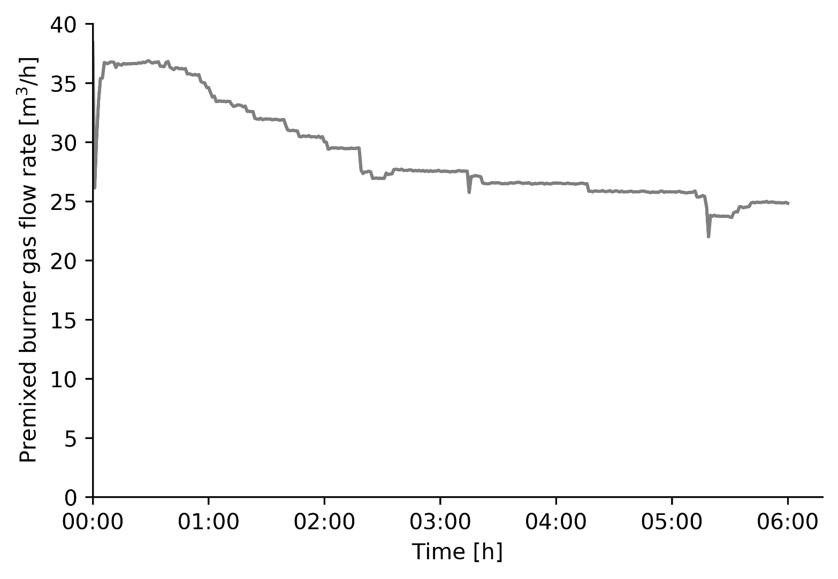
Steam cracking experiments
Total premixed burner gas flow rate to cells 3 & 4: only first experiment
Joost Van Thielen, Stijn Vangaever

Slide 14
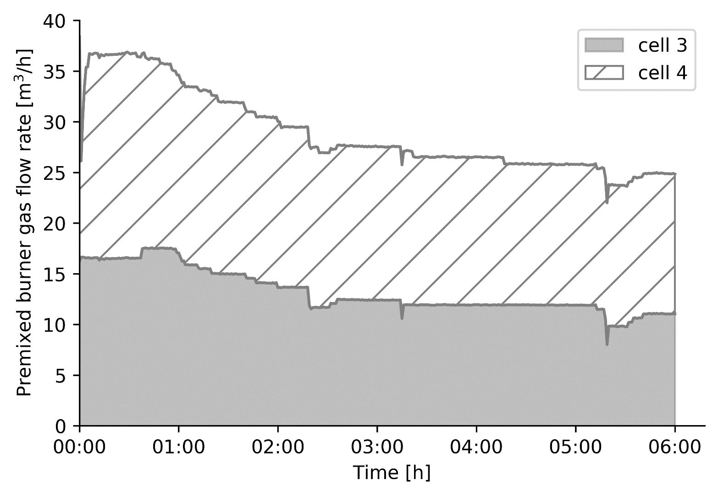
Steam cracking experiments
Total premixed burner gas flow rate to cells 3 & 4: only first experiment
Flow rate to cells 3 and 4 summed
Joost Van Thielen, Stijn Vangaever

Slide 15
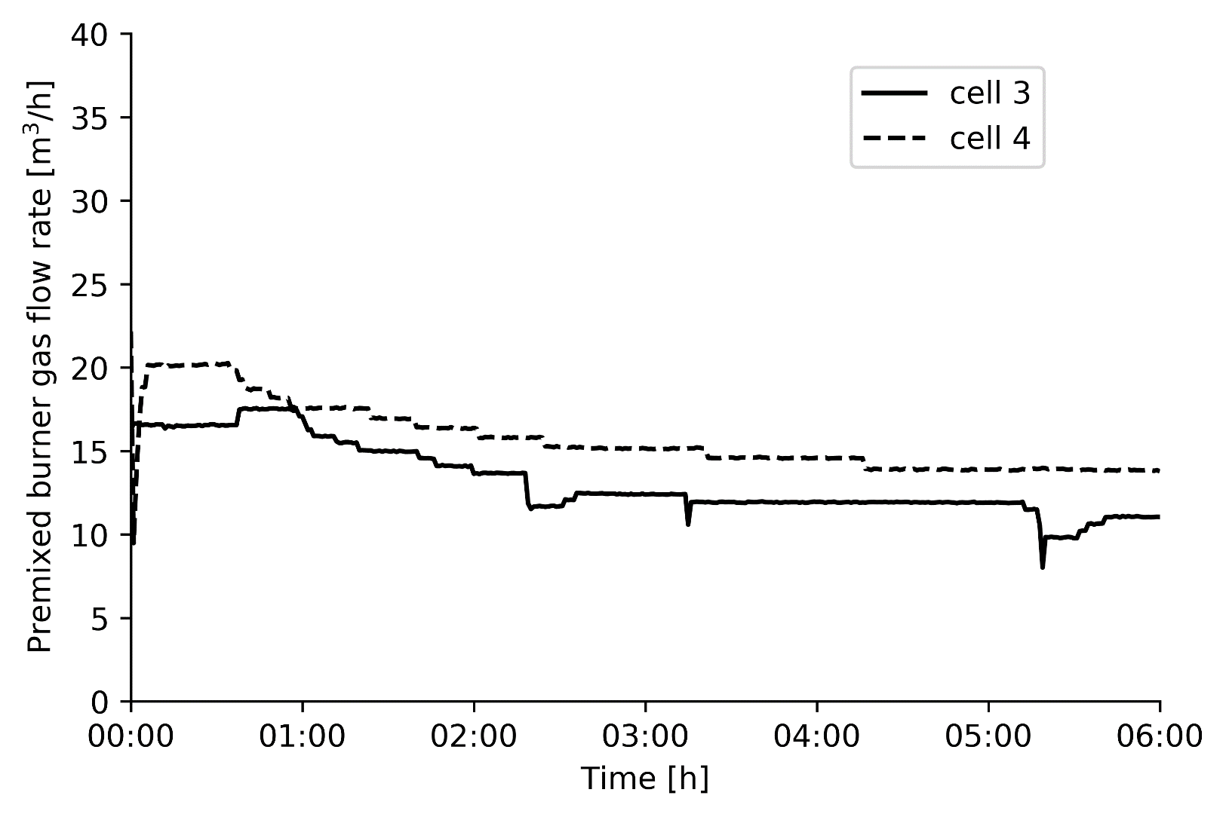
Steam cracking experiments
Total premixed burner gas flow rate to cells 3 & 4: only first experiment
Flow rate to cells 3 and 4 individually

Slide 16
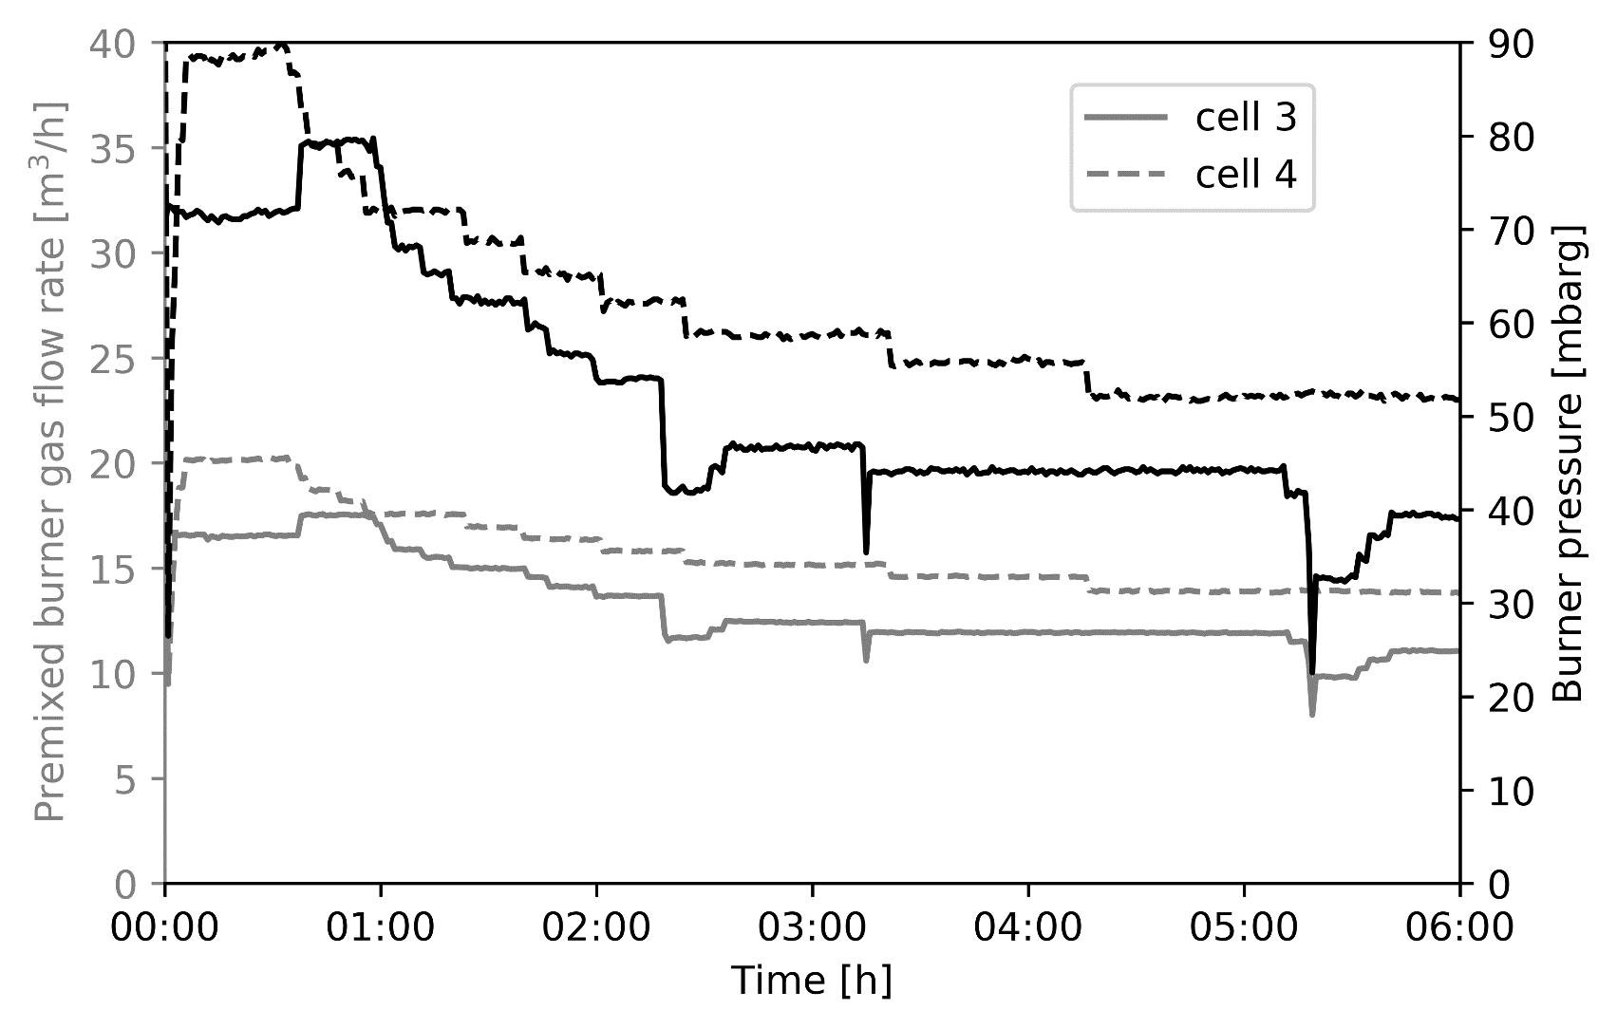
Steam cracking experiments
Total premixed burner gas flow rate to cells 3 & 4 compared to burner pressure
Bernoulli’s equation correlates velocity
to burner pressure → burner pressure at steady-state will be used to compare flow rate
Joost Van Thielen, Stijn Vangaever

Slide 17
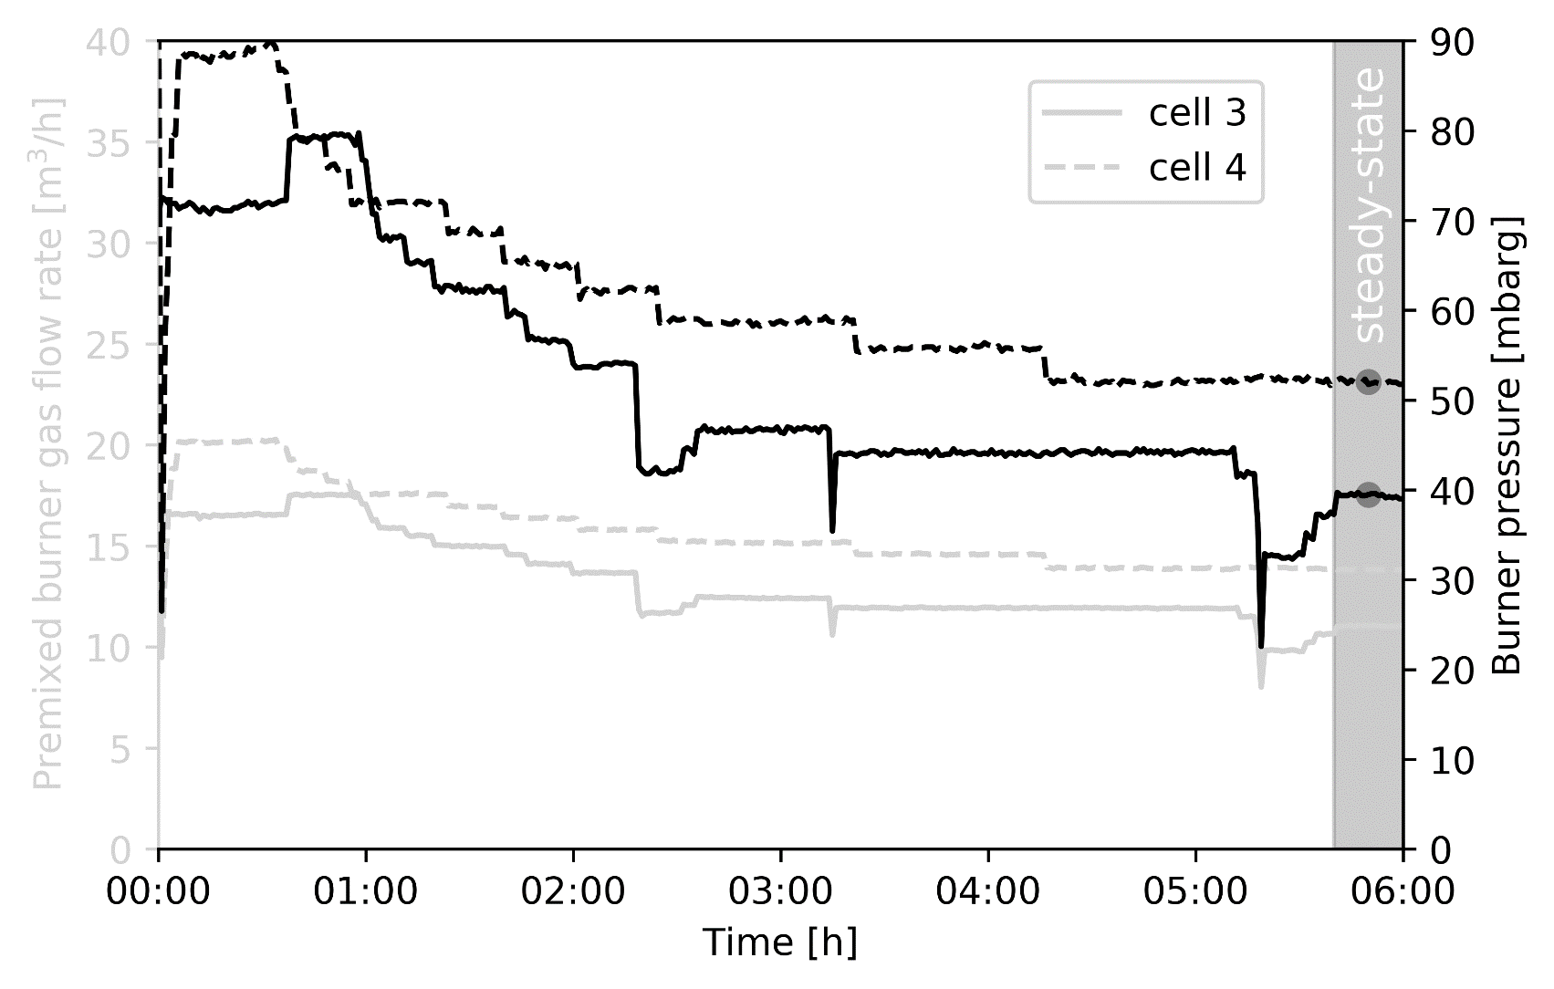
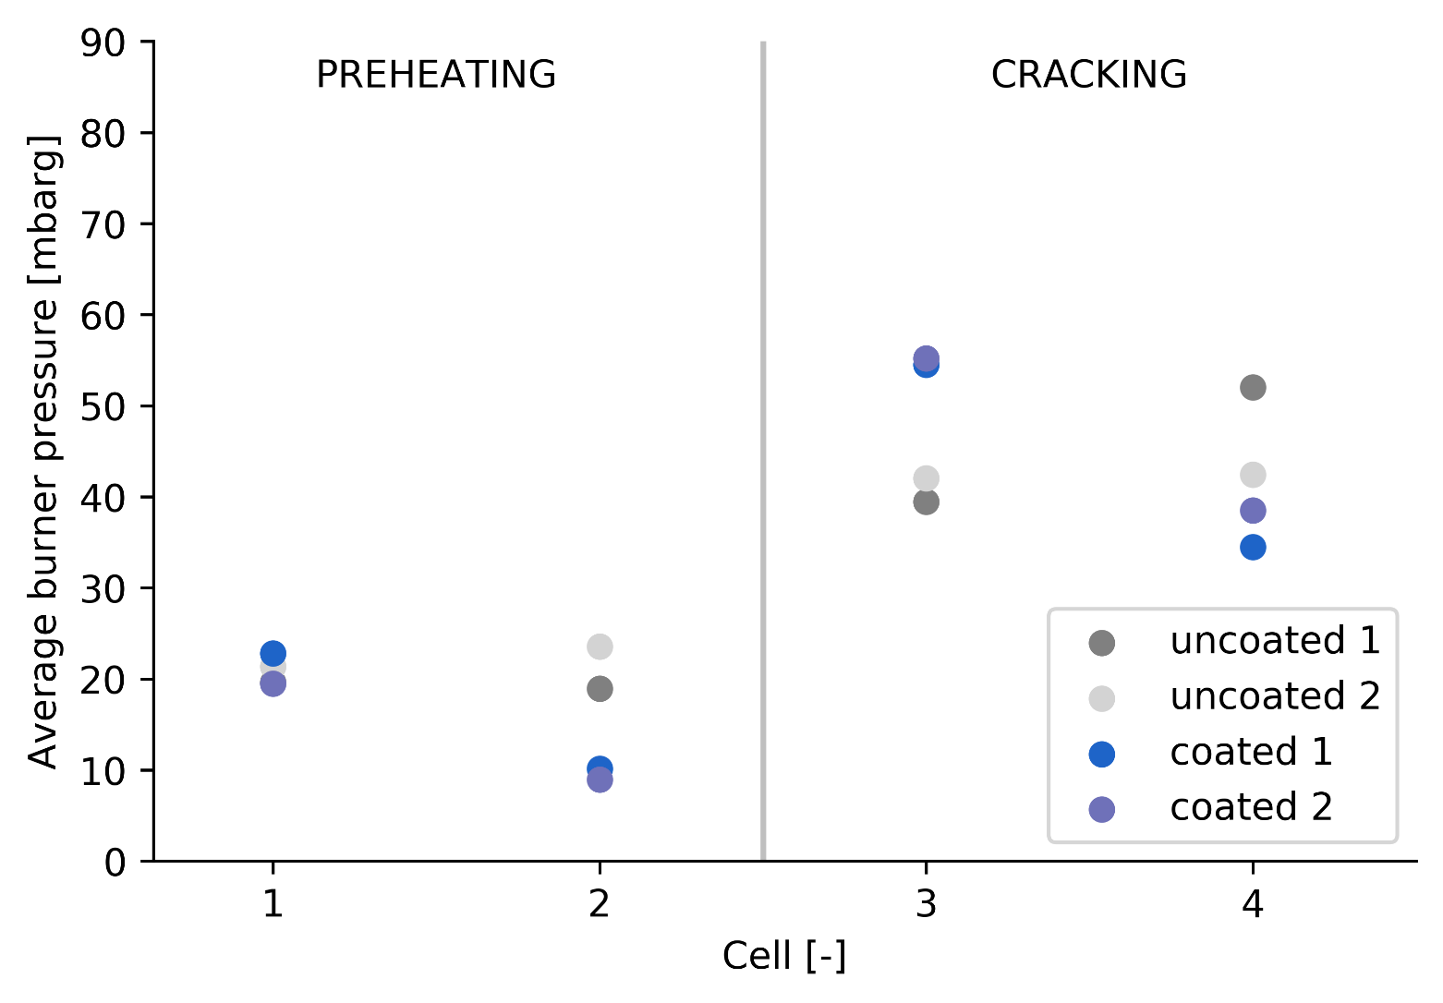

Steam cracking experiments
Average burner pressure at steady-state
over-firing in cell three to compensate for other cells
5 % energy savings after application of high emissivity coating
Be careful when interpreting the results because of to the highly coupled nature of the process
Joost Van Thielen, Stijn Vangaever

Slide 18
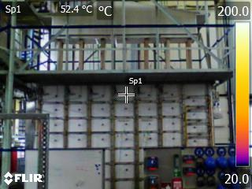
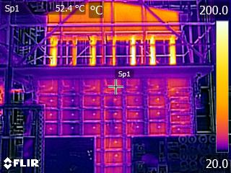
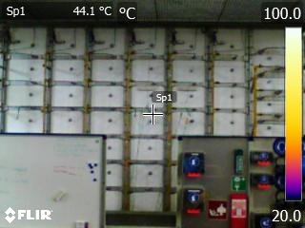
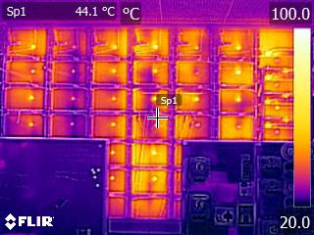
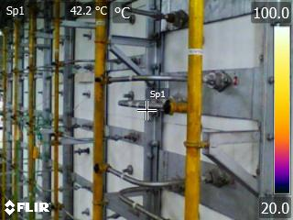
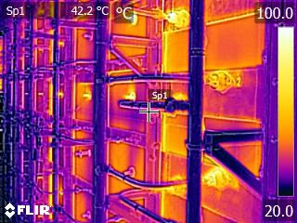
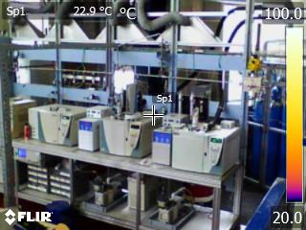
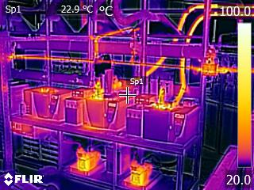
Steam cracking experiments: infrared camera
Joost Van Thielen, Stijn Vangaever

Slide 19
Theoretical validation:
Radiative heat transfer in a simplified enclosure

Slide 20
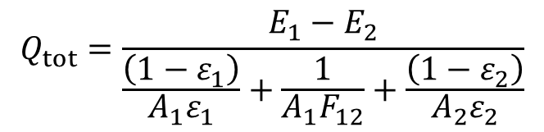









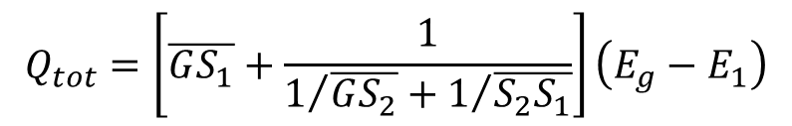



Radiative heat transfer
‘Electric circuit analogy’ for the radiative heat transfer between two gray surfaces:
Tube-in-box enclosure gray-plus-clear gas solution with adiabatic refractory:
$$E_{1}$$
$$E_{2}$$
$$Q_{tot}=\frac{E_{1}−E_{2}}{\frac{\left(1−ε_{1}\right)}{A_{1}ε_{1}}+\frac{1}{A_{1}F_{12}}+\frac{\left(1−ε_{2}\right)}{A_{2}ε_{2}}}$$
$$\frac{\left(1−ε_{1}\right)}{A_{1}ε_{1}}$$
$$\frac{1}{A_{1}F_{12}}$$
$$\frac{\left(1−ε_{2}\right)}{A_{2}ε_{2}}$$
Source
Sink
$A$ surface area m²
$E$ blackbody energy W/m²
$F$ view factor -
$Q$ net heat flux W
$a$ portion of blackbody radiation emitted in the
non-clear wavelength range -
$ε$ emissivity -
$ρ$ reflectivity -
$τ$ transmissivity -
$\overline{GS}$ total gas-to-surface exchange area m²
$\overline{SS}$ total surface-to-surface exchange area m²
$$A_{2},T_{2},ε_{2}$$
$${\overline{S_{1}S_{2}}}/{A_{1}}=\frac{aε_{1}ε_{2}}{D}+\frac{\left(1−a\right)ε_{1}ε_{2}}{1−ρ_{2}\left(1−ε_{1}{A_{1}}/{A_{2}}\right)}$$
$${\overline{GS_{1}}}/{A_{1}}=\frac{ε_{1}ε_{G}\left(1/τ+ρ_{2}{A_{1}}/{A_{2}}\right)}{D}$$
$${\overline{GS_{2}}}/{A_{2}}=\frac{ε_{2}ε_{G}\left(1/τ+ρ_{1}{A_{1}}/{A_{2}}\right)}{D}$$
$$T_{G}$$
$$q$$
$$A_{1},T_{1},ε_{1}$$
$$Q_{tot}=\left[\overline{GS_{1}}+\frac{1}{1/{\overline{GS_{2}}}+1/{\overline{S_{2}S_{1}}}}\right]\left(E_{g}−E_{1}\right)$$
with $D=\frac{1}{τ}−ρ_{2}\left[1−\frac{A_{1}}{A_{2}}\left(ε_{1}+\frac{ρ_{1}ε_{g}}{a}\right)\right]$
Modest, M. F. (2013). Radiative heat transfer. Academic press.
Joost Van Thielen, Stijn Vangaever

Slide 21
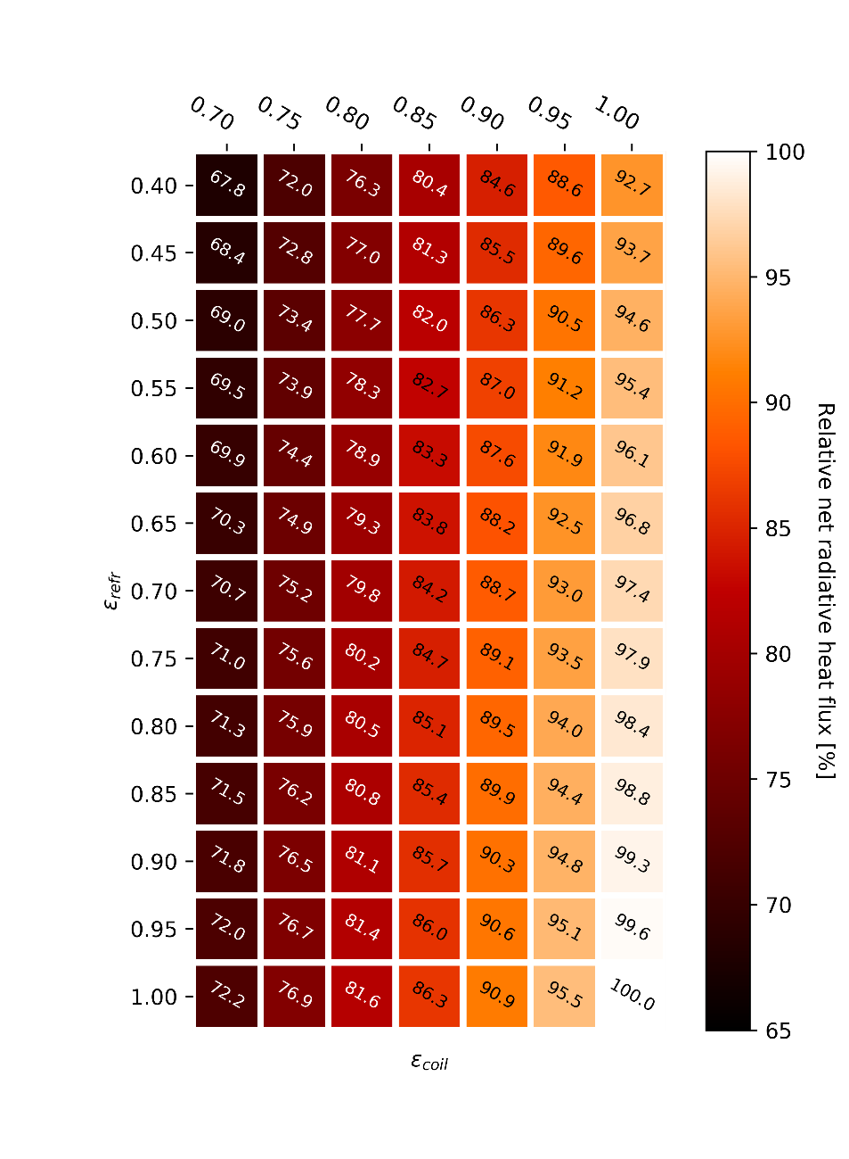
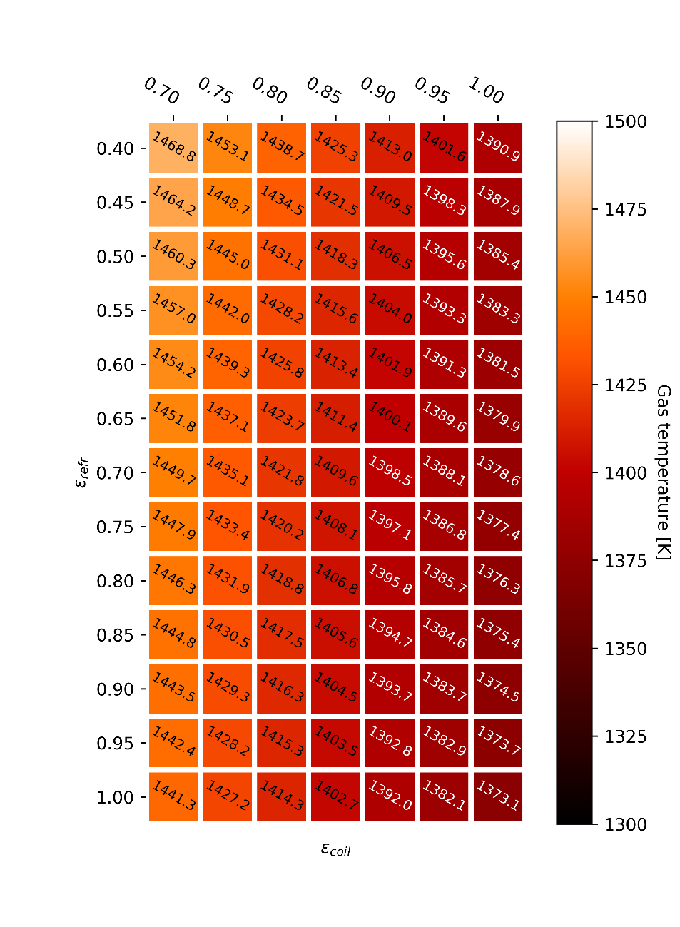










Radiative heat transfer in a tube-in-box enclosure
$$A_{2},T_{2},ε_{2}$$
$$A_{2},T_{2},ε_{2}$$
Constant gas phase temperature:
$$T_{G}$$
Constant heat flux:
$$T_{G}$$
$$q$$
$$q$$
$$A_{1},T_{1},ε_{1}$$
$$A_{1},T_{1},ε_{1}$$
coil emissivity
coil emissivity
refractory emissivity
Relative net radiative heat flux [%]
refractory emissivity
Gas phase temperature [K]
$$T_{1}=1173 K$$
$$T_{G}=1373 K$$
$T_{1}=1173 K$
$q=constant$
Joost Van Thielen, Stijn Vangaever

Slide 22
Conclusions

Slide 23
Conclusions
The principle benefit in utilizing High Emissivity Coatings in ethylene furnaces will be from coating the radiant walls and ceiling.
By increasing the refractory spectral emissivity from 0.4 to 0.9+ the benefits are increased furnace efficiency, increased production, reduced fuel usage and reduce GHG emissions.
5 % energy savings was noted in the pilot plant even with an incomplete HE coating application and essentially no load to re-radiate to. Full scale ethylene plant energy savings should be higher and in the range of 7 -12 %.
New Products have been developed by Emisshield to increase HE coatings thermal stability and operating life at soak temperatures of ethylene.
HE coating R&D and development will continue to improve this technology to make the most efficient ethylene furnaces.
Joost Van Thielen, Stijn Vangaever

Slide 24

Acknowledgments
The IMPROOF partners & colleagues at the LCT
This work has received funding from the European Union Horizon 2020 Programme (H2020-SPIRE-04-2016) under grant agreement n°723706

Slide 25

Laboratory for CHEMICAL TECHNOLOGY
Technologiepark 125, 9052 Ghent, Belgium
✉ info.lct@ugent.be https://www.lct.ugent.be https://www.improof.cerfacs.fr

